Slide 1
Teaching and assessing
C3 and C4 Mathematics:
Effective approaches to enhance student achievement
For Keynote Educational
Rose Jewell

Slide 2
Outline for the day
Introductions
Teaching more advanced Algebra
Looking ahead to the new 2017 A Level specifications
Methods for teaching differentiation and integration
Preparing students for examinations:
an examiner’s insights
Teaching vectors: practical demonstration session
Improving outcomes in Trigonometry
Final discussion, questions, afternoon tea and depart

Slide 3
Teaching more advanced Algebra
Building an understanding of functions
Exponential and logarithmic functions
Transformation of functions
Manipulating algebraic fractions
Resources and activities to reduce student algebraic errors

Slide 4
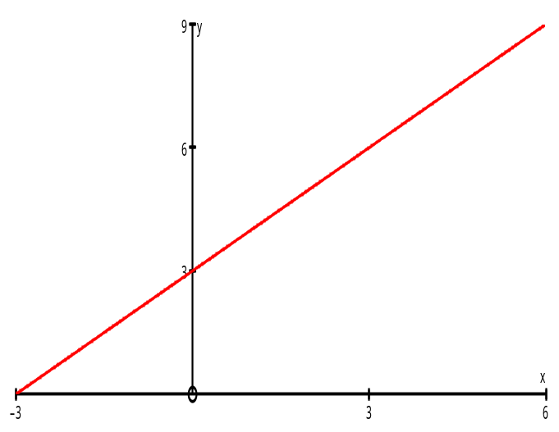
Mappings
DOMAIN
RANGE
( co-domain)
-3
1
4
6
0
4
7
9
y = x + 3
x
x + 3
one – to – one mapping

Slide 5
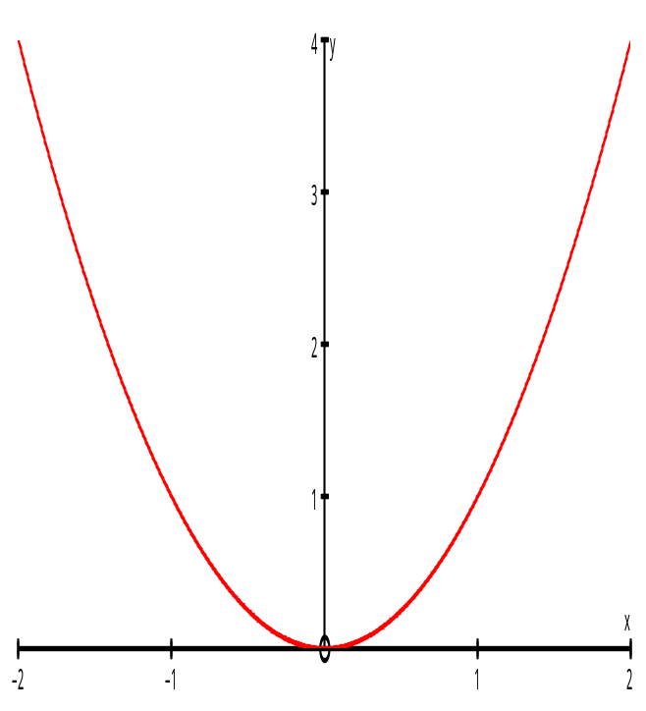
DOMAIN
RANGE
( co-domain )
y = x²
-1
1
-2
2
1
4
x
x²
many – to – one mapping

Slide 6
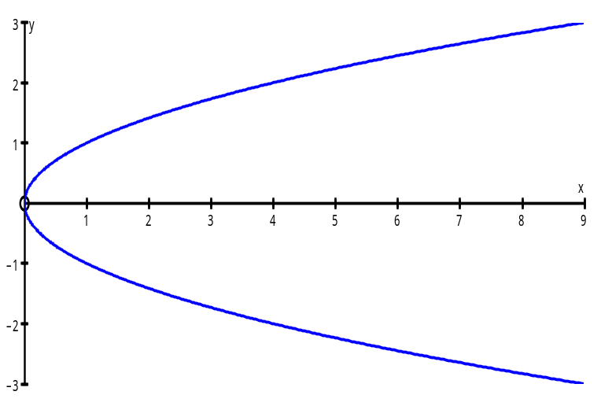
x → ±√x
-3
-2
-1
0
1
2
3
y = ±√x
0
1
4
9
one – to – many mapping

Slide 7
‘is a factor of’
2
3
2
3
4
6
many – to – many mapping

Slide 8
Definition of a FUNCTION
every element of the domain is mapped to exactly ONE element in the range
ie it must be a
one - to - one mapping
or
many - to - one mapping

Slide 9
Notation
The function that maps x onto 3x can be written as
f : x → 3x
or
f (x) = 3x
or
y = 3x

Slide 10
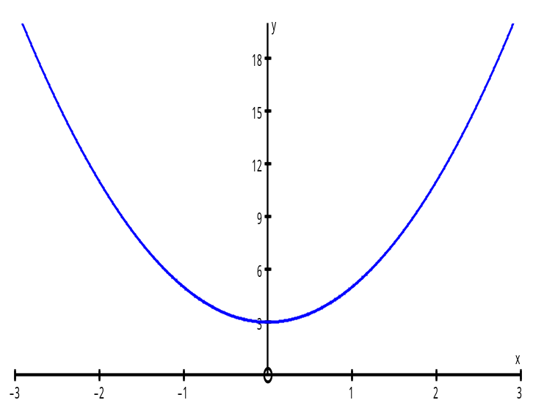
Example
Given that f(x) = 2x² + 3 and find
(a) f(2) (b) the value of a such that f(a) = 35
(c) the range of the function
(a) f(2) =
2 x 2² + 3
= 11
(c)
(b)
2a² + 3 = 35
2a² = 32
a² = 16
a = ± 4
The range of f(x) is
f(x) ≥ 3

Slide 11
Transformations of Graphs
Reminder
Starting with y= f (x), we obtain | by the transformation
y = f (x + a) | translate a to the LEFT
y = f (x) + a | translate a UP
y = af (x) | stretch parallel to the y-axis, factor a
y = f (ax) | stretch parallel to the x-axis, factor 1/a
y = - f (x) | reflection in the x-axis
y = f (-x) | reflection in the y-axis

Slide 12
Examples
1. Sketch the graph of y = ( x – 2 )² + 3
start with y = x²
y = (x – 2)² is a horizontal translation of +2
y = (x – 2)² + 3 is a horizontal translation of +2
followed by a vertical translation of +3
y
6
4
2
x
-2
0
2
4

Slide 13
Sketch the graph of y = cos 2x - 1
start with y = cos x
y = cos 2x is a horizontal stretch, factor 1/2
y = cos 2x - 1 is a horizontal stretch, factor 1/2
followed by
a vertical translation of -1
y
1
0
270
x
90
180
360
-1

Slide 14
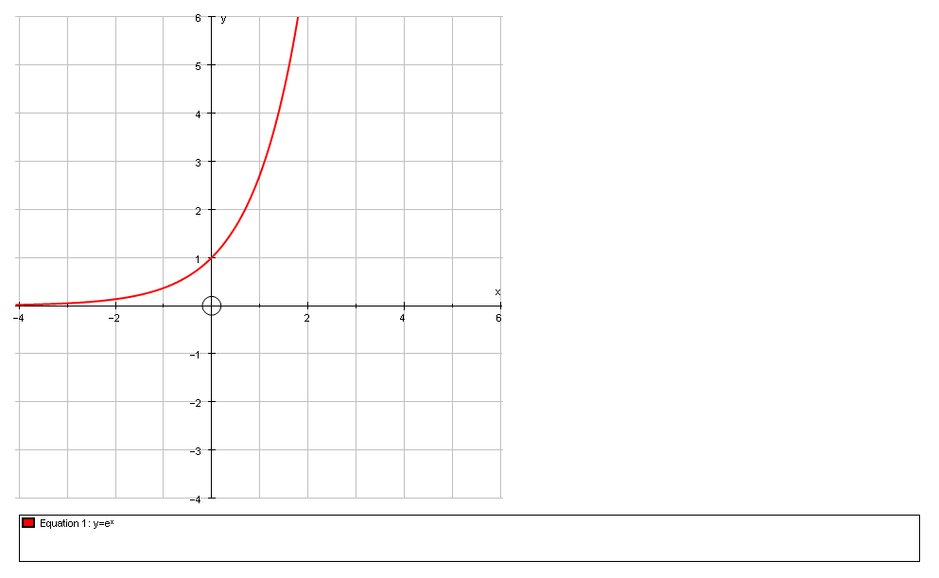
The exponential function
Investigation using graph drawing software
Draw y = 2^{x}
Attach a point and tangent
Record the x, y and gradient at several points and look for relationships
Repeat for y = a^{x} and vary a until gradient = y co-ordinate at every point.

Slide 15
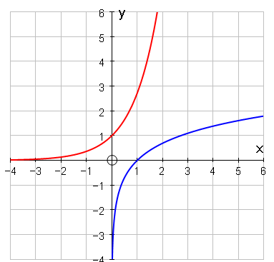
Graph of y = lnx
Reflection of y = e^{x} in the line y = x

Slide 16
Sketching transformations of exponential graphs
Sketch y = 10 + 20e^{-2t}

Slide 17
The laws of indices
These are true more generally as well

Slide 18
The laws of logs
These are true for any base, including e

Slide 19
Rewriting log and index form
Example Given that and that A = 10 when t = 0 and A = 8 when t = 2, find the values of A₀ and k.
Predict the value of A when t =5

Slide 20
Algebraic fractions - misconceptions
Which of these are right and which are wrong?
(a), (c) (e) and (g) are correct – the others are howlers!
Write a summary of what makes sense when simplifying fractions

Slide 21
Simplifying algebraic fractions
Cancel factors in the top with factors in the bottom
Simplify

Slide 22
Simplify these fractions
1.
2.
3.

Slide 23
Dividing (or fractions) when the top is not easily factorised
Write the x +3 on the outside and the first term on the inside
x | x³
3
Fill in the first column

Slide 24
Dividing (or fractions) when the top is not easily factorised
How many more x² do we need?
 | x²
x | x³
3 | 3x²

Slide 25
Dividing (or fractions) when the top is not easily factorised
Finish off the table
 | x²
x | x³ | 4x²
3 | 3x²

Slide 26
Dividing (or fractions) when the top is not easily factorised
 | x² | 4x | -12
x | x³ | 4x² | -12x
3 | 3x² | 12x | -36

Slide 27
What do you think of this?
What should it be?
Notes:
Plenary

Slide 28
Partial fractions
Check what you need for your syllabus – some need a quadratic factor as well as distinct linear factors and a repeated linear factor.

Slide 29
Example with a repeated factor
Multiply by denominator
Substitute x = -1
Substitute x = 2

Slide 30
Equate the x² coefficients
Just watch when integrating this that only the first two terms give natural logs
Now rewrite

Slide 31
How to reduce student algebraic errors
Consistent approach
Debunking misconceptions
Realising when expressions are equivalent
The importance of checking
  Routines built in
  Table mode

