Slide 1
Preparing students for examinations
An examiner’s insights
Feedback from recent examinations
Understand where students lose marks and how questions are marked
Engage with exemplar student material to highlight common errors
How to develop crucial examination technique to boost exam grades

Slide 2
Examiners’ reports
Great resource for teachers and candidates
General and overall comments
Specific feedback on questions often discussing common errors and pitfalls.

Slide 3
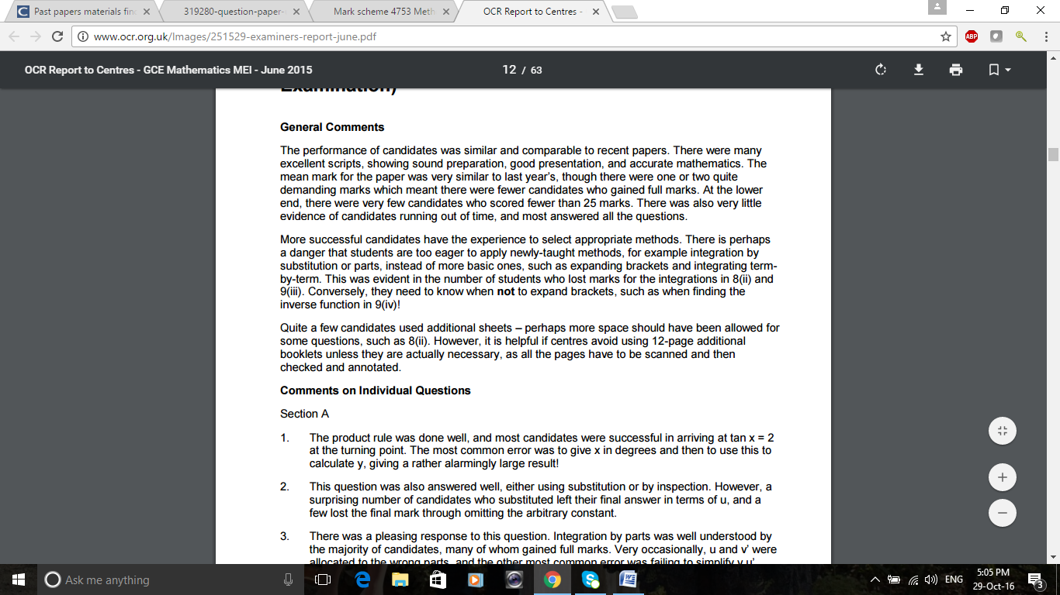
The examiner’s reports
MEI Jun1 15 Core 3 General comments

Slide 4
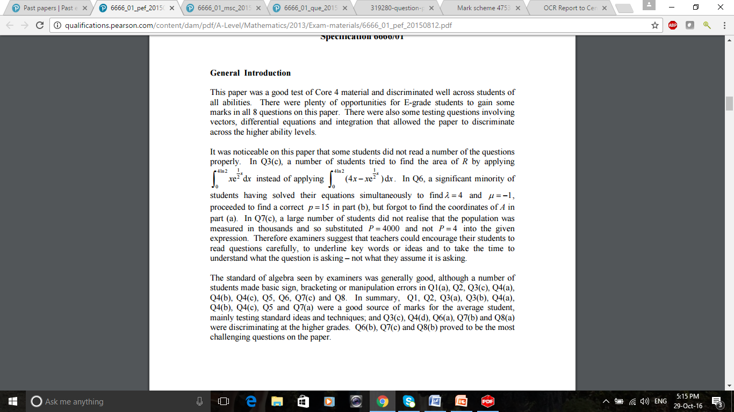
The examiner’s reports
Edexcel June 15 C4 General comments

Slide 5
Nailing the method marks
NO marks yet!
Almost all the marks are awarded for the un-simplified answer.
Stop here if timing is a big issue
The expansion is infinite and only valid for |x|<1

Slide 6
The “Show that…” question
Show that the Cartesian equation of the curve given parametrically by
is
Method 1 – ignore the answer and use it as a check
Method 2 – use the answer, and make a very clear conclusion
Moving on – don’t use your incorrect answer – use theirs in the next parts of the question!

Slide 7
The “Show that…” question
Method 1
Method 2
So the Cartesian equation is
Put the correct answer on the end of incorrect or incomplete work

Slide 8
Getting the best out of follow-through
Use the given answer even if you don’t get it
Show how you use your answer from (i) in part (ii) – It’s evidence rather than working out
If you omit a part completely, but need the answer to do the next bit, make one up – but put it in the answer space which would otherwise be blank so that it looks like FT in the next part
Be aware the hard bit might be the first bit – don’t abandon the whole question if the first bit is impossible

Slide 9
Understanding the commands
Show that
Find
Calculate
Write down
Evaluate
Find the exact value of
Prove
… giving your answer …
Hence…
You may find the whole question paper has no questions in it at all!

Slide 10
Using the mark allocation
A really useful guide to how difficult the examiner thinks the question is can be found by looking at the mark allocation – if it’s worth a lot of marks, it will be a multi-stage problem – if it’s only worth one or two, there should be an easy way of doing it!
A question at the start worth only one or two marks may well be a hint on how to do the rest of the question

Slide 11
A marking exercise
Have a go at the question
Mark your own using the mark scheme
Look at the handwritten solution – how many marks would it get?
How could the candidate have done a bit better?

Slide 12
Crossed out work
It varies from one board to another – find out how to use it for your benefit!

Slide 13
Don’t hide your work
Examiners mark a scanned image of the script. They don’t usually see the whole page at once. Make it easy for him or her to find your answer – the worst is a bit of work at the top of the page and then a re-start much lower down – they might not find it

Slide 14
Be kind to your examiner
Your examiner may have taught all day at school, cooked a meal and put the kids to bed before starting marking, so make it easy for them to find the marks you deserve. If your write clearly most of the time, they are more inclined to puzzle over confused thinking to find a B mark that might be lurking there!

