Slide 1
Teaching vectors
Advanced teaching methods
for building an understanding of 3D vectors
Understanding the equations of a line in 2 or 3 dimensions
Scalar product and the angle between 2 lines
Algebraic and geometric approaches
Encouraging mathematical discussion

Slide 2
Teaching methods
Tried and trusted e³ lesson – explanation, example exercise – efficient and it works!
Use physical objects to help students envisage what the question is asking
Use 3D graphing software – Autograph or Geogebra.
www.tsm-resources.com/Autograph
Flipped learning, or peer teaching using online resources

Slide 3
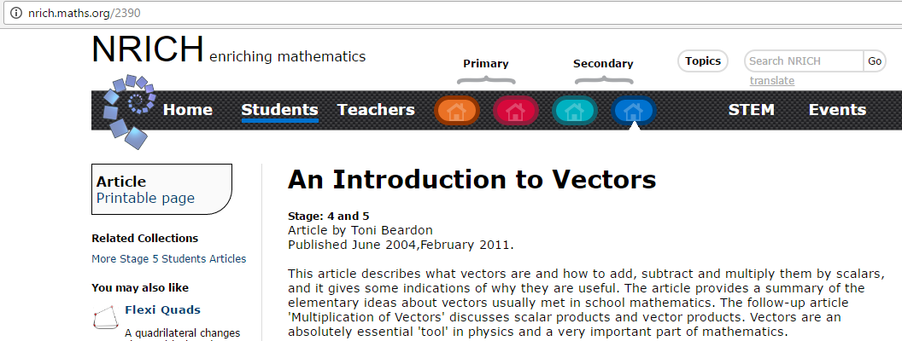
A few things I’ve found - nrich
Nrich 2390 go to http://nrich.maths.org/2390
Investigative approach nrich439

Slide 4
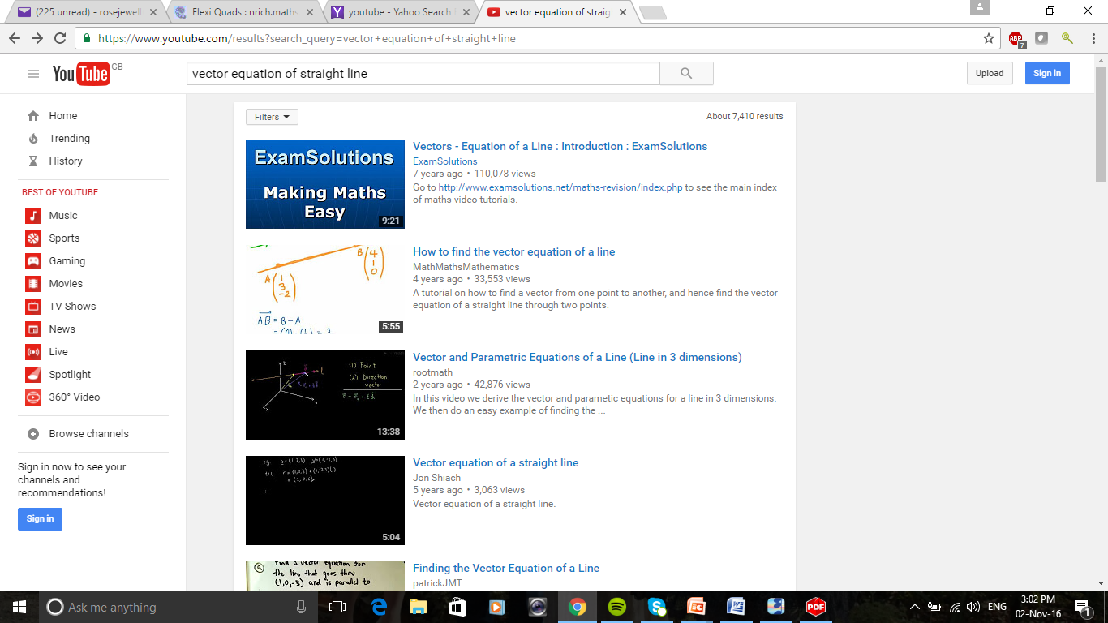
Students go to YouTube for everything!

Slide 5
The vector equation of a straight line passing through the point A with position vector a and parallel to the vector u
R
u
R = a general point on the line
A
OR = OA + AR
r
a
r = a + λu
O
where λ is a scalar parameter

Slide 6
Vector Equation of a Line in 3D
Find the equation of the line
passing through the point ( 3, 4, 1 ) and ( 5, 7, 7 )
Discussion point
What other answers are there that would also be correct?
Equation is given by
r = a + λb

Slide 7
The Angle Between Two Vectors
a
θ
b
scalar product ( dot product )
cos θ = a . b
|a| |b|
Note: If two vectors a and b are perpendicular
then a . b = 0

Slide 8
The Angle Between Two Lines in 3D
Example 4
(
1
0
4
)
(
2
-1
-1
)
(
2
-1
3
)
(
3
0
1
)
r =
+ λ
r =
+ μ
The angle between the lines is the angle between their directions
cos θ = a . b
|a| |b|

Slide 9
Geometric and algebraic approaches
Find the shortest distance from C (3,12,3) to the line
Don’t be too quick to provide a solution!
There may be more than one way of doing this!
Draw it in 2D
How do you transfer this thinking into an algebraic method?

Slide 10
Geometric and algebraic approaches
Method One
Find the shortest distance from C (3,12,3) to
P
C (3,12,3)
A (5, -2, 3)

Slide 11
Geometric and algebraic approaches
Method One
P
C (3,12,3)
A (5, -2, 3)
If exact answer needed, find sin from cos using identites
Notes:
You could use identities to find sintheta from costheta and get an exact answer here. This is close to 4root 3

Slide 12
Geometric and algebraic approaches
Method 2
C is the point (3,12,3) and the point P is on the line
CP is perpendicular to the line. Find the co-ordinates of P and the distance of C from the line

Slide 13
CP is perpendicular to the line –
We need scalar product with the direction vector

Slide 15
Check your specification
One of the places where the specifications vary is in the content for vectors – for MEI you need the equation of planes also

