Slide 1
Co-ordinate Geometry for Edexcel C2

Slide 2
What you need to know
How to use the radius and centre of a circle to find its equation
How to use the equation to find radius and centre of a circle
To use angle properties of circles to solve problems in co-ordinate geometry
    Angle in a semicircle is 90⁰
    Angle between radius and tangent is 90⁰
    Perpendicular from the centre to a chord bisects the chord

Slide 3
Toolkit
Distance formula | Gradient formula | Circle properties Radius at 90⁰ to tangent Angle in semi-circle is 90⁰
Midpoint formula | Equation of a line | Equation of a circle centre (a, b) radius r
Solve the equation | Simultaneous equations | Quadratic formula
Parallel Same gradient | Crosses x - axis when y = 0 y - axis when x = 0 | Complete the square
Perpendicular | Factorise | Other end of a diameter Use vectors

Slide 4
Example 1
The points A and B have coordinates (–2, 11) and (8, 1) respectively.
Given that AB is a diameter of the circle C,
show that the centre of C has coordinates (3, 6)
C is the midpoint

Slide 5
The points A and B have coordinates (–2, 11) and (8, 1) respectively.
(b) find an equation for C.
Diameter
Radius
Equation

Slide 6
(c) Verify that the point (10, 7) lies on C.
Find the distance of P from the centre
Distance = radius, so point P lies on the circle

Slide 7
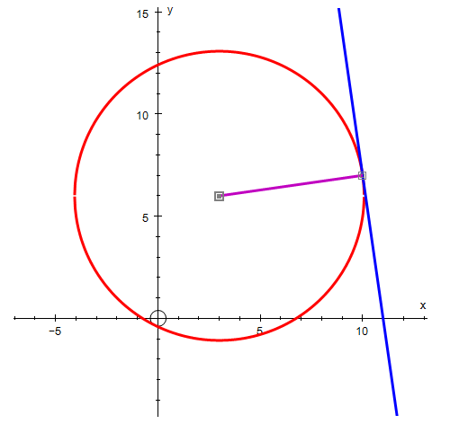
(d) Find an equation of the tangent to C at the point (10, 7), giving your answer in the form
y = mx + c, where m and c are constants.
Tangent perpendicular to the radius
Gradient of the radius
Gradient of the tangent
Equation of the line

Slide 8
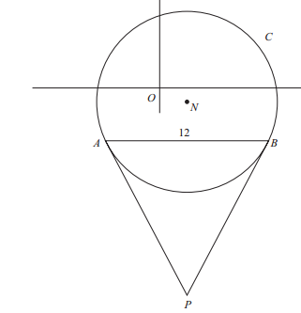
Example 2 (part question)
The diagram shows a sketch of the circle C with centre N
and equation
(a) Write down the coordinates of N.
(b) Find the radius of C.
N is the centre. Compare with

Slide 9
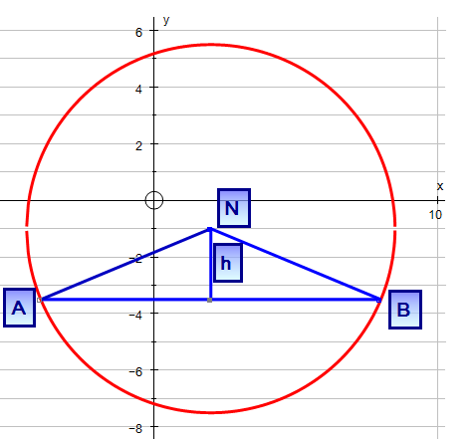
Example 2
The diagram shows a sketch of the circle C with centre N
and equation
The chord AB of C is parallel to the
x-axis, lies below the x-axis and is
of length 12
(c) Find the coordinates of A and B.
y co-ords
x co-ords

Slide 10
Summary
How to use the radius and centre of a circle to find its equation
How to use the equation to find radius and centre of a circle
To use angle properties of circles to solve problems in co-ordinate geometry
    Angle in a semicircle is 90⁰
    Angle between radius and tangent is 90⁰
    Perpendicular from the centre to a chord bisects the chord

