Slide 1
C2 TRIGONOMETRY

Slide 2
What you need to know
The graphs of sine, cosine and tangent
Exact values for 30º, 45º and 60º
The trig identities
Solving trig equations including quadratic ones
Sine and cosine rules
Area formula A = ½absinC
Radians – converting to and from degrees
Arc length and sector area

Slide 3
Formulae you need to learn
In triangle ABC:
Area = ½absinC
For a sector of a circle

Slide 4
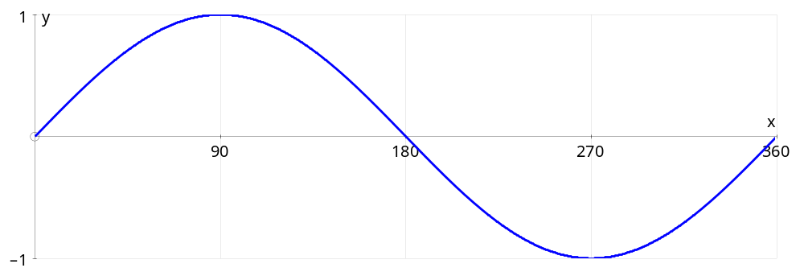
The graph of y=sinx

Slide 5
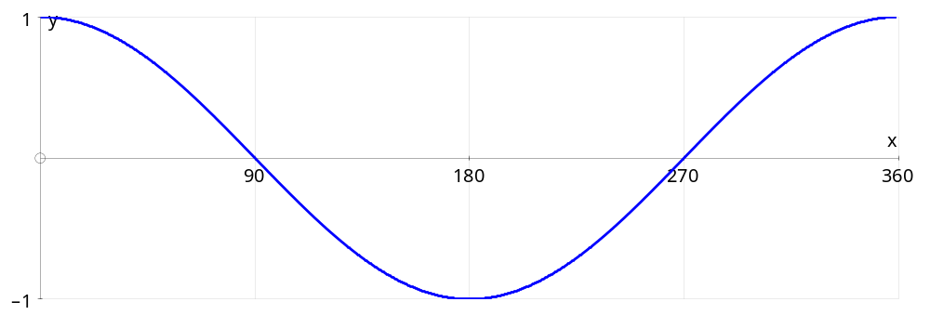
The graph of y=cosx

Slide 6
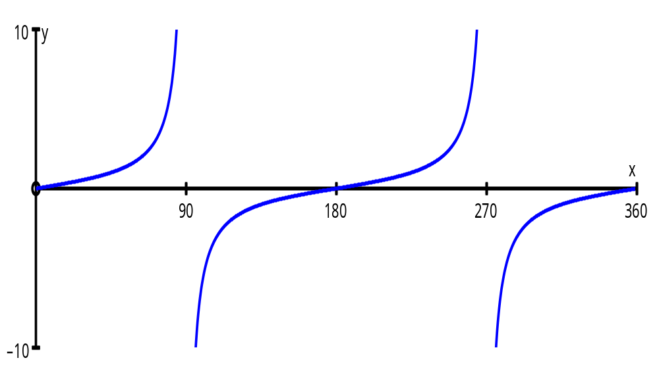
The graph of y=tanx

Slide 7
Important triangles to remember:
30⁰
45⁰
2
√3
√2
1
45⁰
60⁰
1
1
From these triangles we can write down the exact values of sin, cos and tan of 30⁰, 60⁰ and 45⁰
sin 60⁰ =
√3
2
cos 60⁰ =
1
2
tan 60⁰ =
√3
sin 30⁰ =
1
2
cos 30⁰ =
√3
2
tan 30⁰ =
1
√3
1
√2
1
√2
tan 45⁰ =
1
sin 45⁰ =
cos 45⁰ =

Slide 8
Solve sin x = 0.5 for 0 ≤ x ≤ 360⁰
Using a calculator we obtain x = 30⁰
Are there any more solutions?
For sin x
2nd answer is 180 - 1st answer
There is another solution when x = 150⁰
x = 30⁰, 150⁰

Slide 9
Solve cos x = 0.7 for 0 ≤ x ≤ 360⁰
Using a calculator we obtain x = 45.6 ⁰
Are there any more solutions?
There is another solution when x = 314.4 ⁰
For cos x
2nd answer is 360 - 1st answer
x = 45.6⁰, 314.4⁰

Slide 10
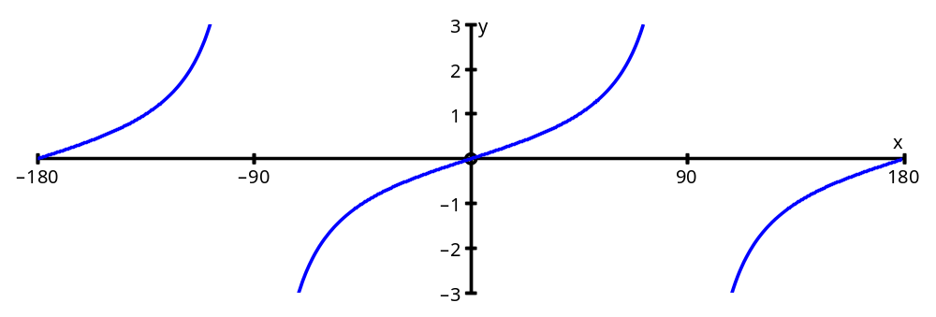
Solve sin x= -cos x for 0⁰ ≤ θ ≤ 360⁰
Dividing by cos x we obtain tan x = -1
Using a calculator we obtain x = -45⁰
Are there any more solutions?
There are other solutions when x = 135⁰,225⁰
For tan x
2nd answer is 180 + 1st answer
x = 135⁰, 225⁰

Slide 11
Solve 2sin 2θ cos ½θ = sin 2θ in the interval 0 ≤ θ ≤ 360⁰
2 sin 2θ cos ½ θ - sin 2θ = 0
sin 2θ ( 2cos ½ θ – 1 ) = 0
sin 2θ = 0
cos ½ θ = 1/2
2θ = 0⁰, 180⁰, 360⁰ 540⁰, 720⁰,
½ θ = 60⁰, 300⁰
θ = 0⁰, 90⁰, 180⁰ 270⁰, 360⁰
θ = 120⁰

Slide 12
Solve the equation 2sin²θ = cos θ + 1 in the interval 0⁰ ≤ θ ≤ 360⁰
Need to work with either sin θ or cos θ
But cos²θ + sin²θ = 1
2( 1 - cos²θ ) = cosθ + 1
Hence sin²θ = 1 - cos²θ
2- 2cos²θ = cosθ + 1
0 = 2cos²θ + cosθ - 1
0 = ( 2cos θ -1)( cosθ + 1)
2cos θ -1 =0 or cos θ + 1= 0
cos θ = ½ or cos θ = -1
cos θ = ½
θ = 60⁰
θ = 300⁰
cos θ = -1
θ = 180⁰
Hence θ = 60⁰, 180⁰, 300⁰

Slide 13
The Sine Rule
B
a
c
C
b
A

Slide 14
The Cosine Rule
B
a
c
C
b
A
a² = b² + c² - 2bc cos A
cos A = b² + c² - a²
2bc

Slide 15
Example 3 Find the length of b when a = 8cm, C = 30º and A = 40º
a=8 cm
b cm
B=30⁰
A=40⁰
b = 8
sin 30 sin 40
You need to be given a pair
(A and a)
to use the sin rule
b = 8 sin 30
sin 40
b = 6.22 cm

Slide 16
Example 4 Find the length c when
a = 6.5cm, b = 8.7cm and C = 100º
We have one of each pair,
so use the cos rule
x
6.5 cm
100⁰
8.7 cm
x² = 8.7² + 6.5² – 2 x 8.7 x 6.5 x cos 100⁰
= 75.69 + 42.25 + 19.74
= 137.58
x = 11.7 cm

Slide 17
Example 5 Use the the sine rule to find two possible values of C when a = 2.4cm c = 6.9cm and A = 19⁰
C
C
5.7 cm
A
19⁰
B
6.9 cm
sin A = sin B = sin C
a b c
sin C = sin 19⁰
6.9 2.4
sin C = 6.9 sin 19⁰
2.4
C = 69.4⁰
or 110.6⁰

Slide 18
sin B = sin 110⁰
5.7 6.9
sin B = 5.7 sin 110⁰
6.9
5.7 cm
110
2.4 cm
B = 39.9 ⁰
B
6.9 cm

Slide 19
The Area of a Triangle
B
a
c
C
b
A
Area = 1 a b sin C
2

Slide 20
Find the base of the triangle,
given that the area is 27.8 cm²
6.5 cm
100⁰
x cm

Slide 21
Measuring Angles in Radians
A
s
r
O
B
r
If arc AB has length s, then angle AOB is radians
360⁰ = 2 π radians
180⁰ = π radians

Slide 22
Degrees
Radians

Slide 23
The Length of an Arc of a Circle
The formula for the length of an arc is simpler when you use radians
length of arc = r θ
r
s
θ
r
θ
r

Slide 24
The Area of a Sector of a Circle
area of sector = 1 r ² θ
2
r
θ
r
Area of sector
= θ x π r ²
2π
= 1 r ² θ
2

Slide 25
Example
Find the arc length, the perimeter and area of a sector of angle 0.8 rad of a circle
whose radius is 5.2 cm.
5.2
0.8
5.2
Arc length =
θ r =
0.8 x 5.2 =
4.16 cm
Perimeter =
4.16 + 5.2 + 5.2 =
14.56 cm
Area =
1 r ² θ =
2
1 x 5.2 ² x 0.8 =
2
10.816 cm ²

Slide 26
Example
Find the area of the segment indicated
Area triangle =
Area of sector =
Segment area=
5cm
0.5

Slide 27
Example
Find the area of the region between the circles
each of radius 10cm
Area triangle =
Area of each sector =
Centre area =

Slide 28
Summary
The graphs of sine, cosine and tangent
Exact values for 30º, 45º and 60º
The trig identities
Solving trig equations including quadratic ones
Sine and cosine rules
Area formula A = ½absinC
Radians – converting to and from degrees
Arc length and sector area

